Slide 1

Amazon Product Review Analysis
Prepared by,
Saud Shaikh
Shakib Hussain
Sanchit Upadhyay
Rohit Kumar
Under the guidance of
Dr Amit Kumar

Slide 2
Project Agenda
Problem Statement / Project Objective
Analysis
a. Data Preprocessing
b. Exploratory Data Analysis (EDA)
c. Text Preprocessing
d. Classification Models
e. Sentiment Analysis
f. Clustering Models
Time Series Analysis
Recommendation

Slide 3
Problem Statement
Project Objective
Inventory Optimization and Demand Forecasting Optimize inventory management by identifying the product categories (clustering as an outcome of text processing) on the customer review data. Predict what kind of products could be in demand (Time Series Analysis).
To develop an automated system to analyze and monitor an enormous number of reviews. By monitoring the entire review history, analyze tone, language, keywords, and trends over time to provide valuable insights that increase the success rate of existing and new products and marketing campaigns.

Slide 4
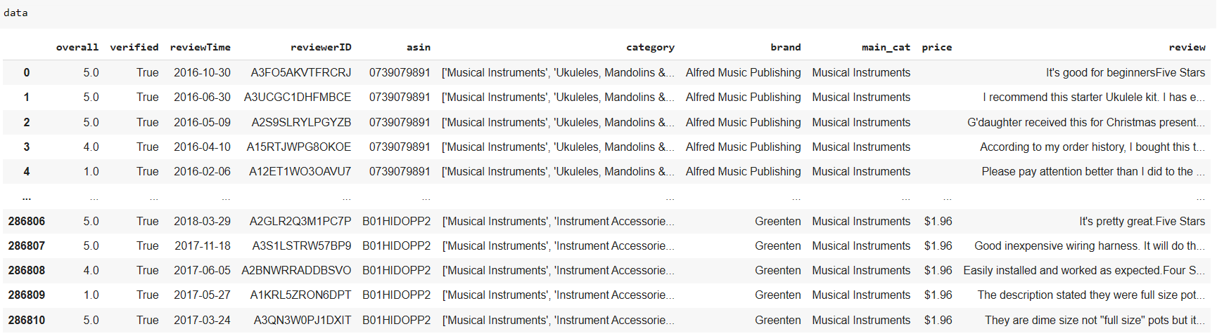
Data Preprocessing
Giving Missing value Treatments
Deleting all duplicate Values
Removing all Unnecessary columns
Adding new columns REVIEW Merging ReviewText+Summary Columns
221848 rows and 10 columns

Slide 5

Exploratory Data Analysis (EDA)

Slide 6
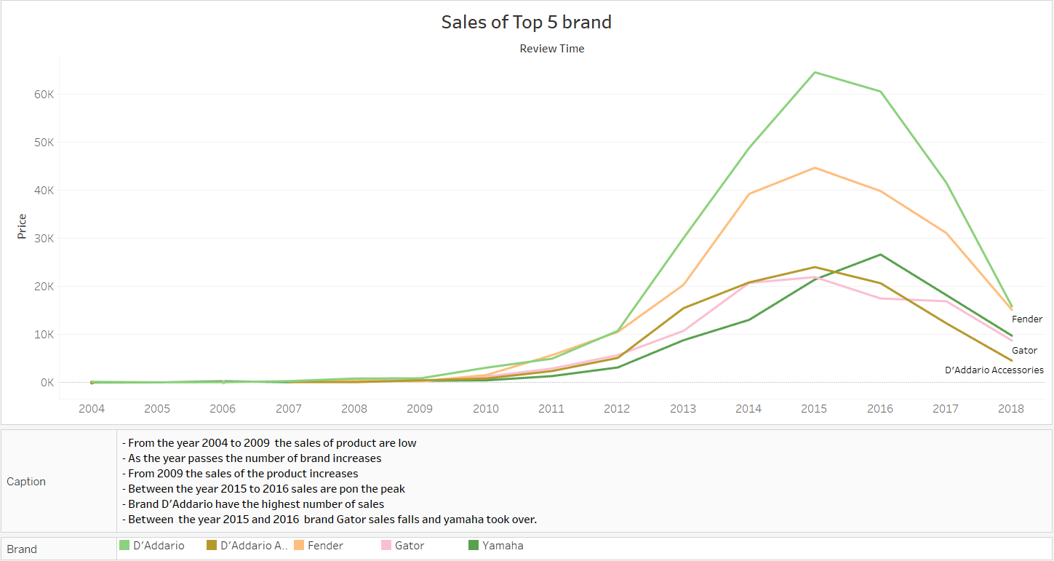
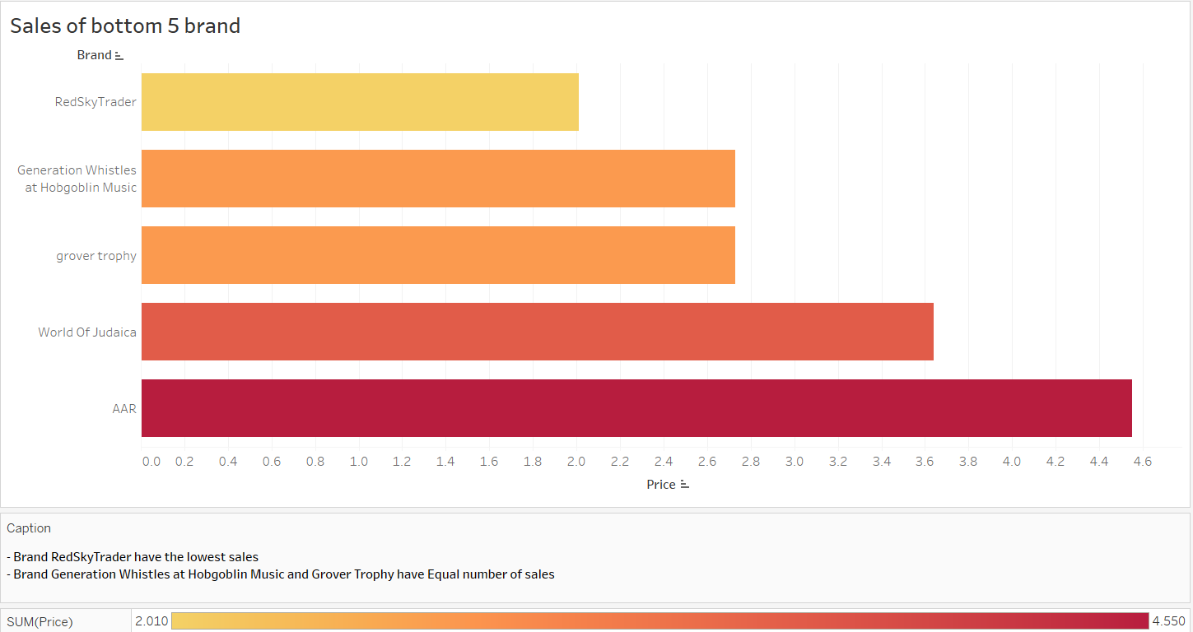
Top /Bottom 5 Sales of Brand
Brand D’Addario have highest number of sales
Brand RedSkyTrader have Lowest number of sales

Slide 7
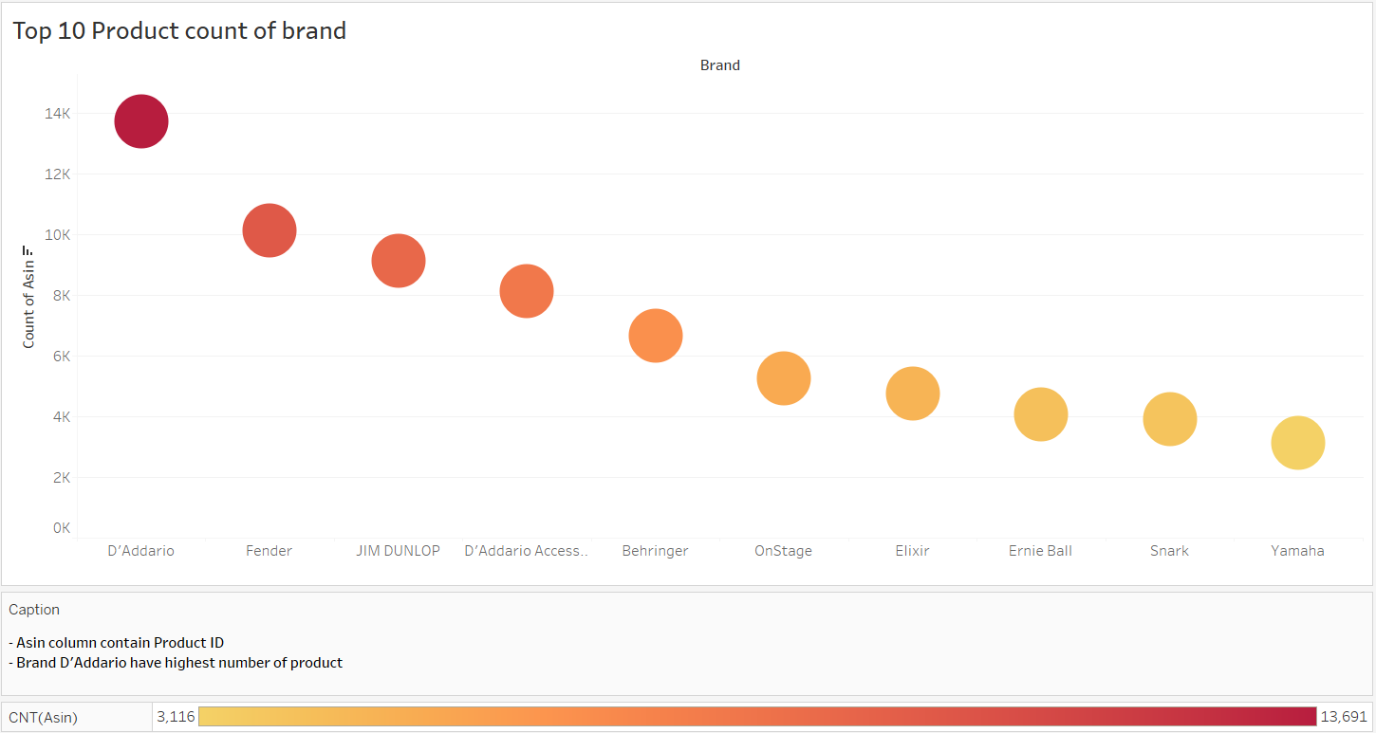
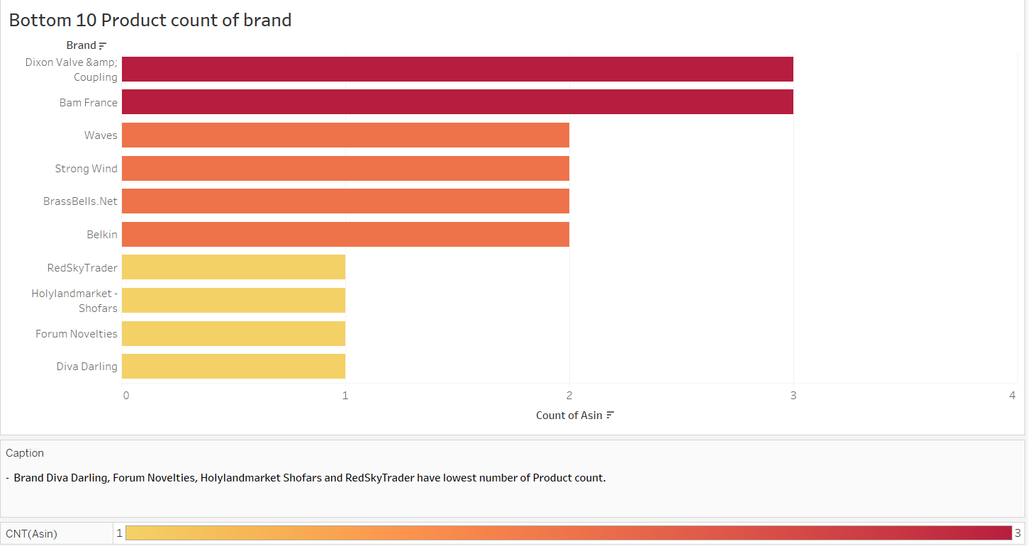
Top /Bottom 10 Product of Brand
Brand D’Addario have highest number of Product
Brand RedSkyTrader have Lowest number of Product

Slide 8
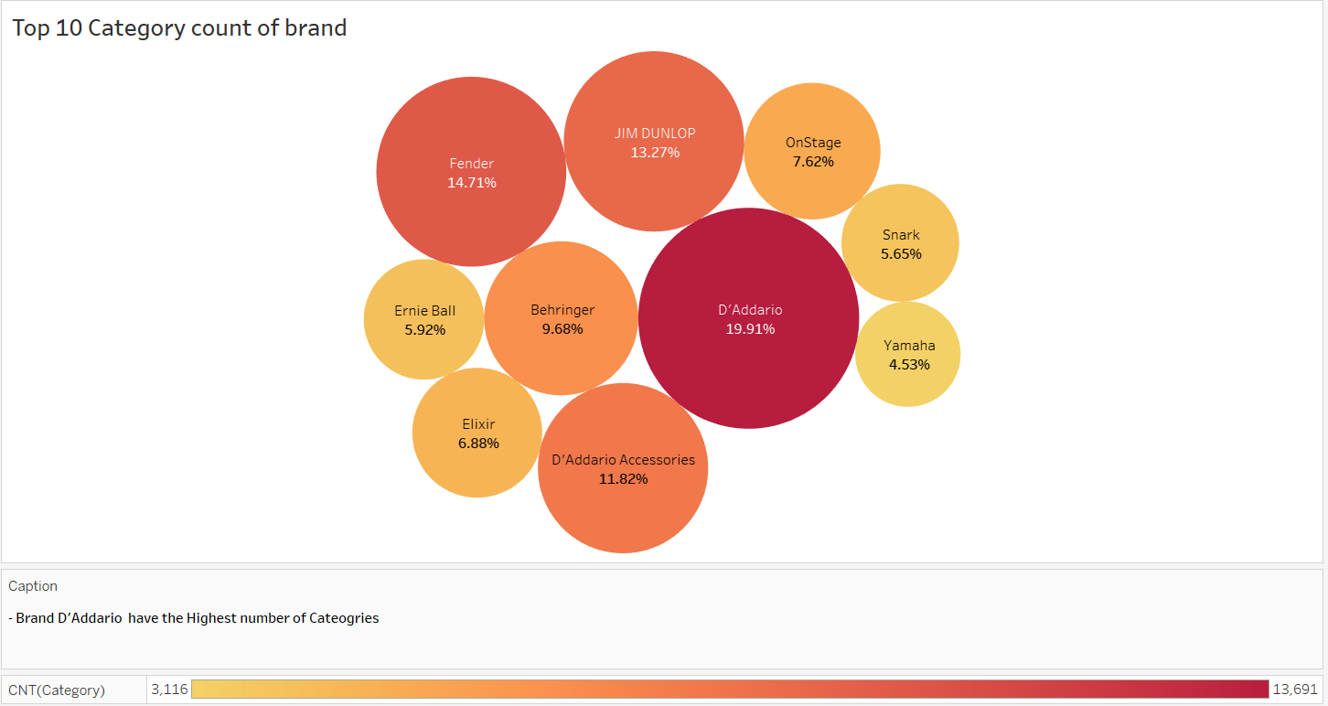
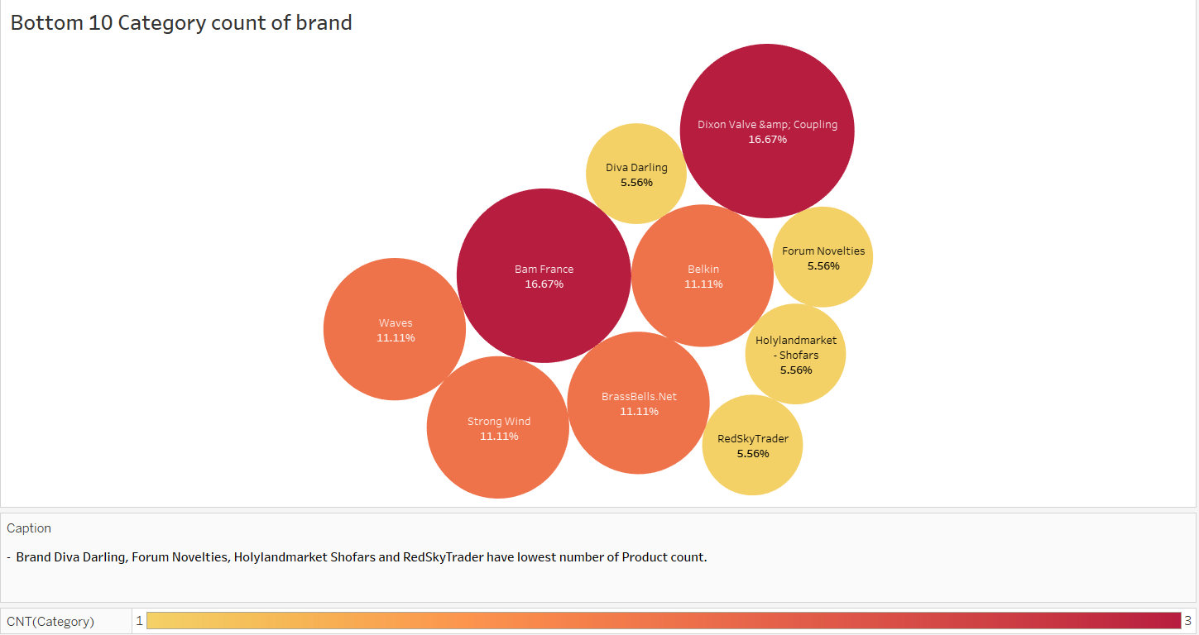
Top /Bottom 10 Categories of Brand
Brand D’Addario have highest number of Categories
Brand RedSkyTrader have Lowest number of Categories

Slide 9
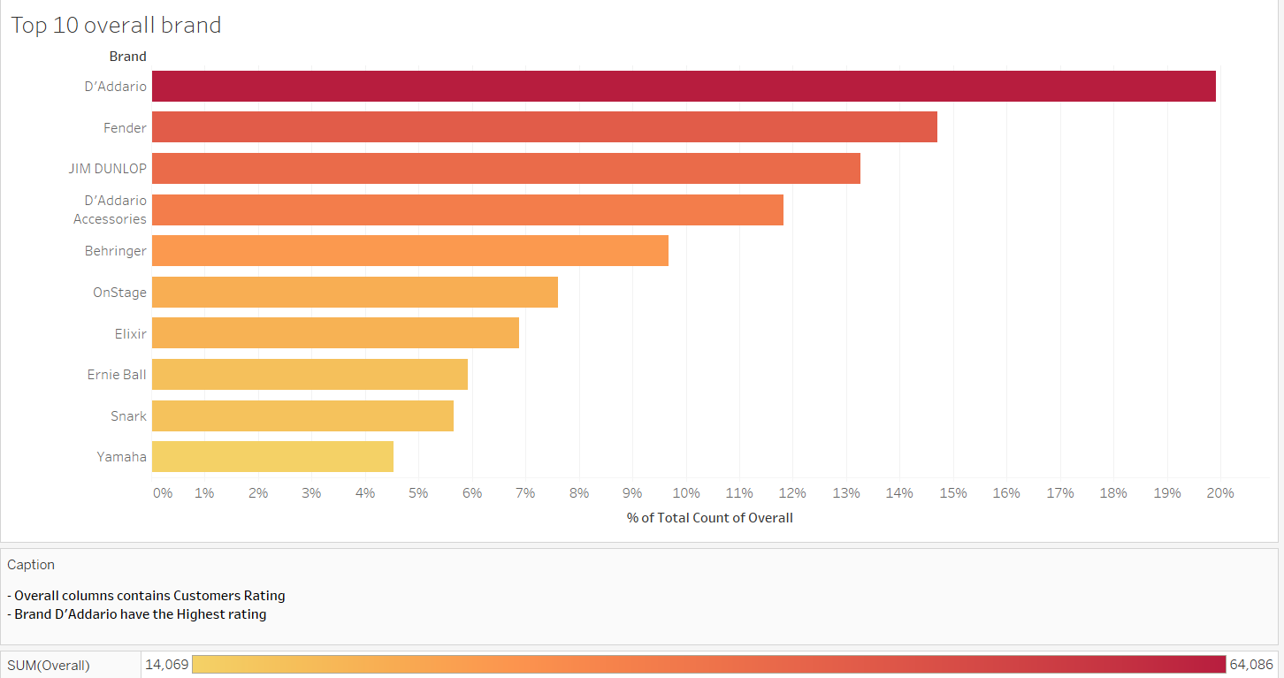
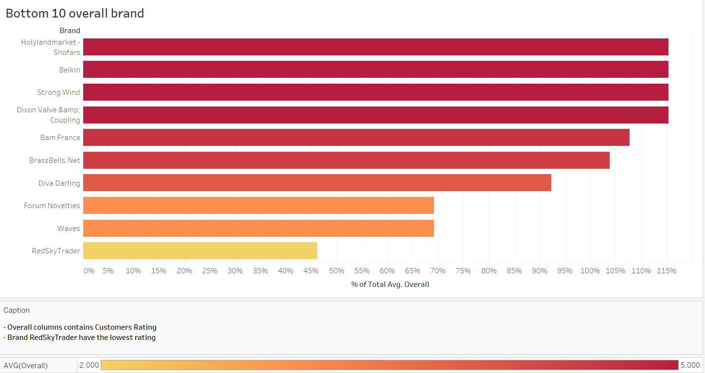
Top /Bottom 10 Overall of Brand
Brand D’Addario have highest number of Overall
Brand RedSkyTrader have Lowest number of Overall
Recommendation
Brand D’Addario have the highest number of sales, Number of Product, Number of Categories and Overall(Rating).
Brand RedSkyTrader have lowest number of sales, Number of Product, Number of Categories and Overall(Rating).

Slide 10

Text Preprocessing
Lemmaitization
Cleaned Text
Removing StopWords
Cleaning Text

Slide 11
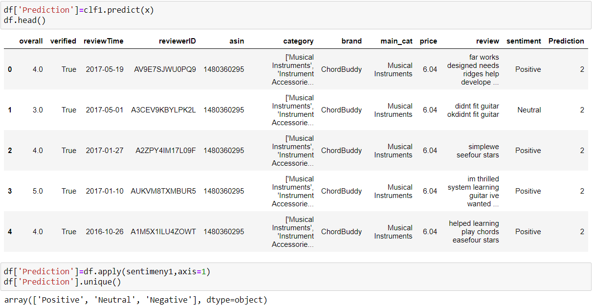
Sentiment Analysis
Defined a function for sentiment analysis
Overall greater then 3 sentiment is Positive
Overall equal to 3 sentiment is Neutral
Overall less then 3 sentiment is Negative

Slide 12
Classification Models
Models used for Classification
1
2
3
4
5
Multinomial Naive Bayes
Multinomial Naïve Bayes algorithm is a probabilistic learning method that is mostly used in NLP.
The algorithm is based on the Bayes theoram and predicts the bag of text
Logistic Regression is a statical method for predicting binary classes.
It computes the probability of an event
A Decision tree is a flowchart-like tree Structure where we an internal node represents feature, the branch represents the outcome
A random forest is a meta estimator that fits a number of decision tree classifiers on various sub-samples of the dataset and use averaging to improve the predictive accuracy and control over-fitting
AdaBoost also called Adaptive Boosting is a technique in Machine Learning used as an Ensemble Method. The most common algorithm used with AdaBoost is decision trees with one level that means with Decision trees with only 1 split
Logistic Regression
Decision Tree Classification Algorithm
Random Forest Classifier
AdaBoost Classifier

Slide 13
Classification Models (Imbalanced Data)
Applied label encoder on sentiment column
Prediction is 2 sentiment is positive
Prediction is 1 sentiment is neutral
Prediction is 0 sentiment is Negative
Classification on Review and Sentiment column
Used TFIDF functions
Multinomial Naive Bayes
Class | Precision | Recall | F1-Score | Support
0 | 1.00 | 0.01 | 0.01 | 3323
1 | 1.00 | 0.03 | 0.07 | 3651
2 | 0.88 | 1.00 | 0.93 | 48625
Logistic Regression
Class | Precision | Recall | F1-Score | Support
0 | 0.73 | 0.49 | 0.58 | 3323
1 | 0.60 | 0.21 | 0.31 | 3651
2 | 0.92 | 0.99 | 0.95 | 48625

Slide 14
Decision Tree Classification Algorithm
Class | Precision | Recall | F1-Score | Support
0 | 0.41 | 0.40 | 0.41 | 3323
1 | 0.30 | 0.25 | 0.28 | 3651
2 | 0.92 | 0.93 | 0.93 | 48625
Random Forest Classifier
Class | Precision | Recall | F1-Score | Support
0 | 0.76 | 0.21 | 0.33 | 3323
1 | 0.90 | 0.14 | 0.24 | 3651
2 | 0.89 | 1.00 | 0.94 | 48625
AdaBoost Classifier
Class | Precision | Recall | F1-Score | Support
0 | 0.64 | 0.30 | 0.41 | 3323
1 | 0.51 | 0.09 | 0.15 | 3651
2 | 0.90 | 0.99 | 0.94 | 48625
Recommendation
Logistic Regression gives the highest values:- accuracy: 0.9069767441860465 recall: 0.9069767441860465 f1-score: 0.889477614208318 precision: 0.8893875929222128 so, Model 2 is best fit model for our Dataset.

Slide 15
Classification Models (SMOTE Function)
Multinomial Naive Bayes
Class | Precision | Recall | F1-Score | Support
0 | 0.93 | 0.94 | 0.93 | 48570
1 | 0.82 | 0.97 | 0.89 | 48524
2 | 0.97 | 0.79 | 0.87 | 48398
Logistic Regression
Class | Precision | Recall | F1-Score | Support
0 | 0.91 | 0.94 | 0.93 | 48570
1 | 0.88 | 0.92 | 0.90 | 48524
2 | 0.93 | 0.86 | 0.90 | 48398
Decision Tree Classification Algorithm
Class | Precision | Recall | F1-Score | Support
0 | 0.88 | 0.91 | 0.89 | 48570
1 | 0.86 | 0.87 | 0.87 | 48524
2 | 0.90 | 0.85 | 0.87 | 48398

Slide 16
Classification Models (SMOTE Function)
Random Forest Classifier
Class | Precision | Recall | F1-Score | Support
0 | 0.98 | 1.00 | 0.99 | 48570
1 | 0.97 | 0.99 | 0.98 | 48650
2 | 0.99 | 0.95 | 0.97 | 48625
AdaBoost Classifier
Class | Precision | Recall | F1-Score | Support
0 | 0.65 | 0.73 | 0.69 | 48570
1 | 0.63 | 0.55 | 0.59 | 48650
2 | 0.70 | 0.71 | 0.71 | 48625
Recommendation
Logistic Regression gives the highest values accuracy: 0.9084829406427845 recall:0.9084829406427845 f1-score: 0.9082935176131418 precision:0.9095375176588235 So, Model 2 is best fit model for our BALANCE DataSet.
Conclusion
SO, THERE IS MUCH DIFFERENCE BETWEEN THE BALANCE AND INBALANCE DATA LOGISTIC MODEL

Slide 17
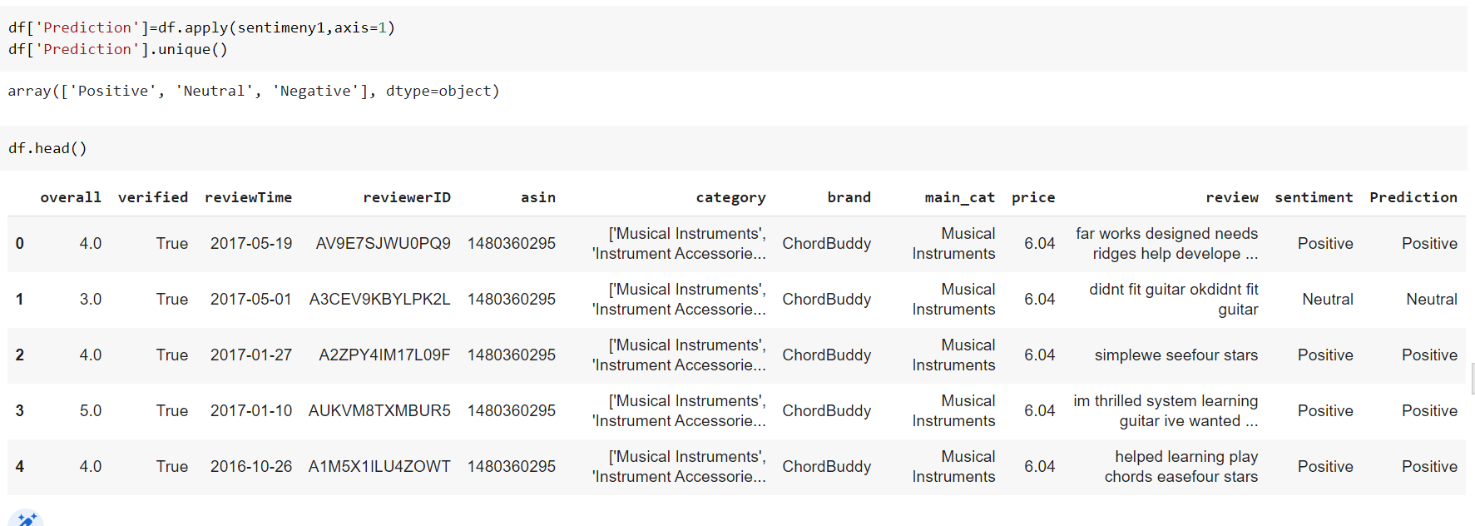
Sentiment Prediction
Sentiment Analysis for column overall from dataset overall is basically our customer rating given to the product.
Defined a function for sentiment analysis where if overall rating is less than 3 it will fall under Negative if overall rating is equal to 3 it is Neutral and if overall rating is greater then 3 it is positive.
Added a new column named as sentiment where it have values in positive, neutral and negative
Defined function for Prediction where if overall rating is less than 3 Prediction is 0 if overall rating is equal to 3 prediction is 1 and if overall rating is greater then 3 prediction is 2.
Added new column based on sentiments as prediction

Slide 18
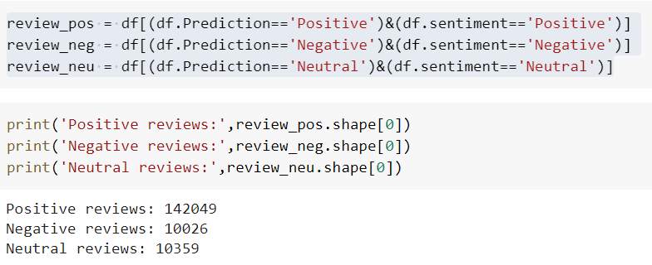
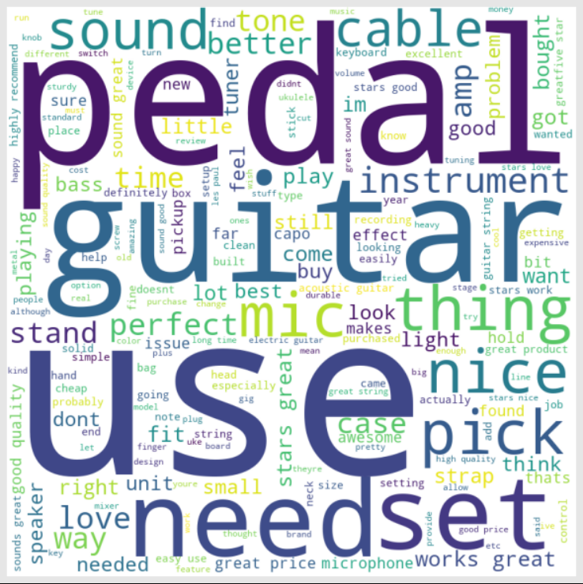
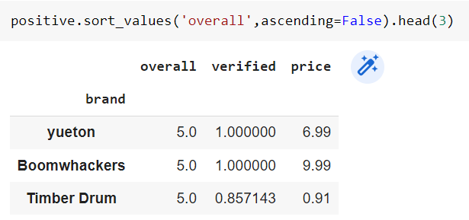
Separating the Sentiments
INFERENCE
Top 3 Brand with Positive Sentiment
Most Common Words use +
Most Common Positive Review words

Slide 19
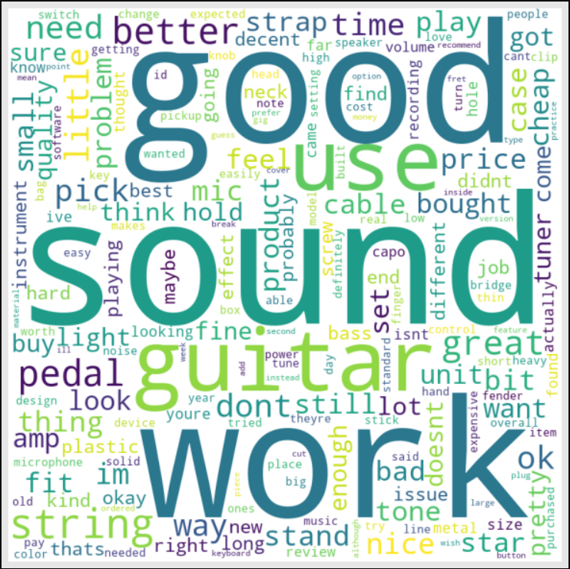
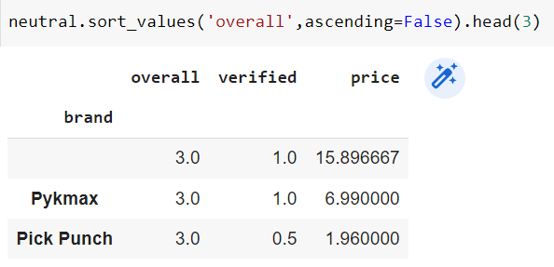

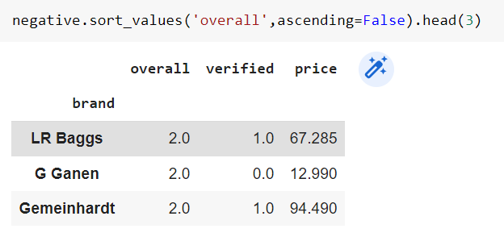
INFERENCE
Top 3 Brand with Neutral Sentiment
Most Common Words use for neutral reviews
Most Common Words use for negative reviews
Top 3 Brand with Negative Sentiment

Slide 20
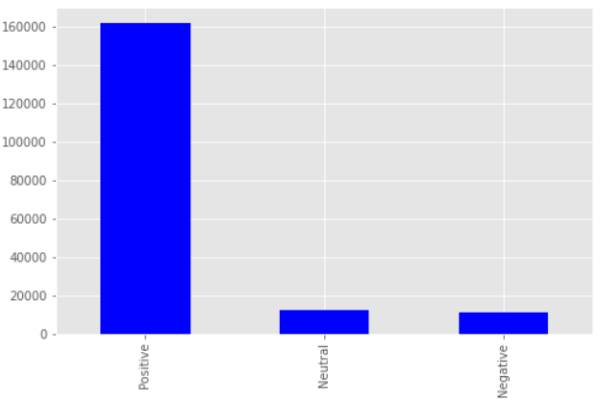
Time Series Analysis
Splitting data in sentiment
Here taking only brand or overall rating for the forecasting the future prediction.
D’Addirio having large scale of business in amazon

Slide 21
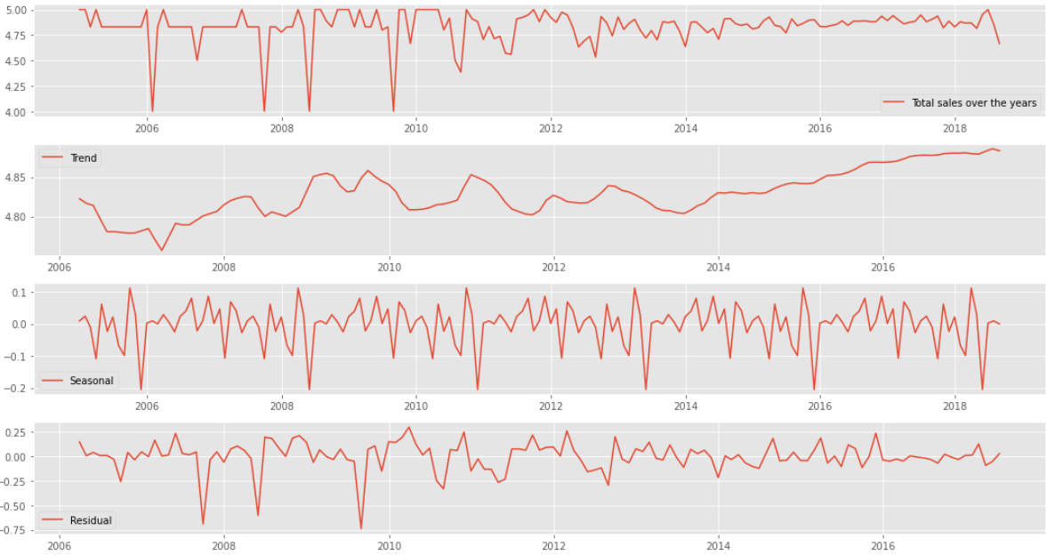
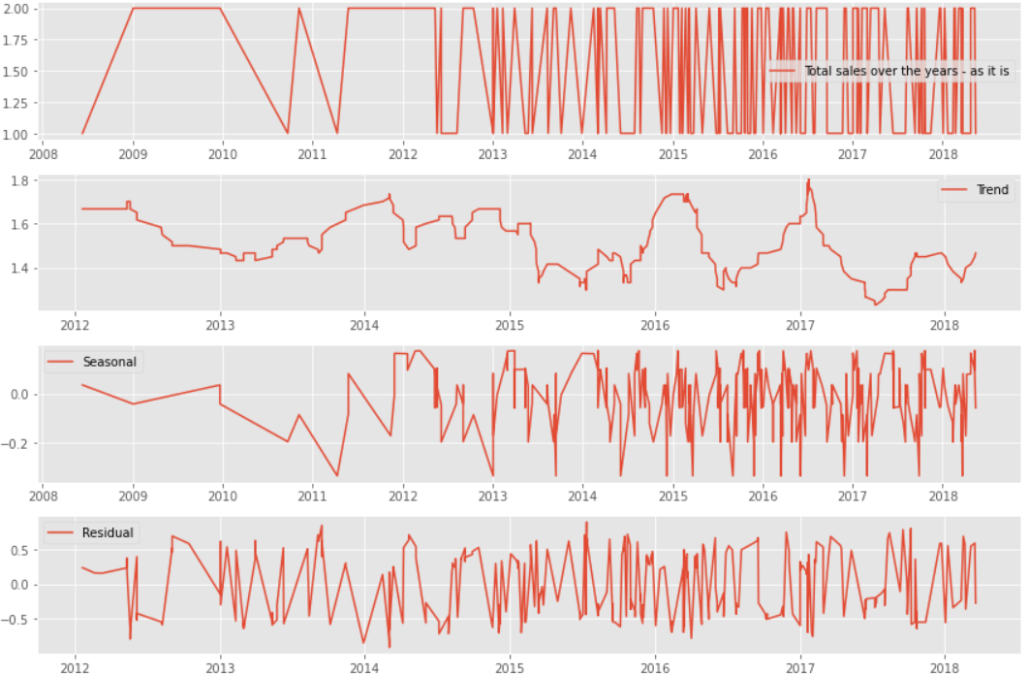
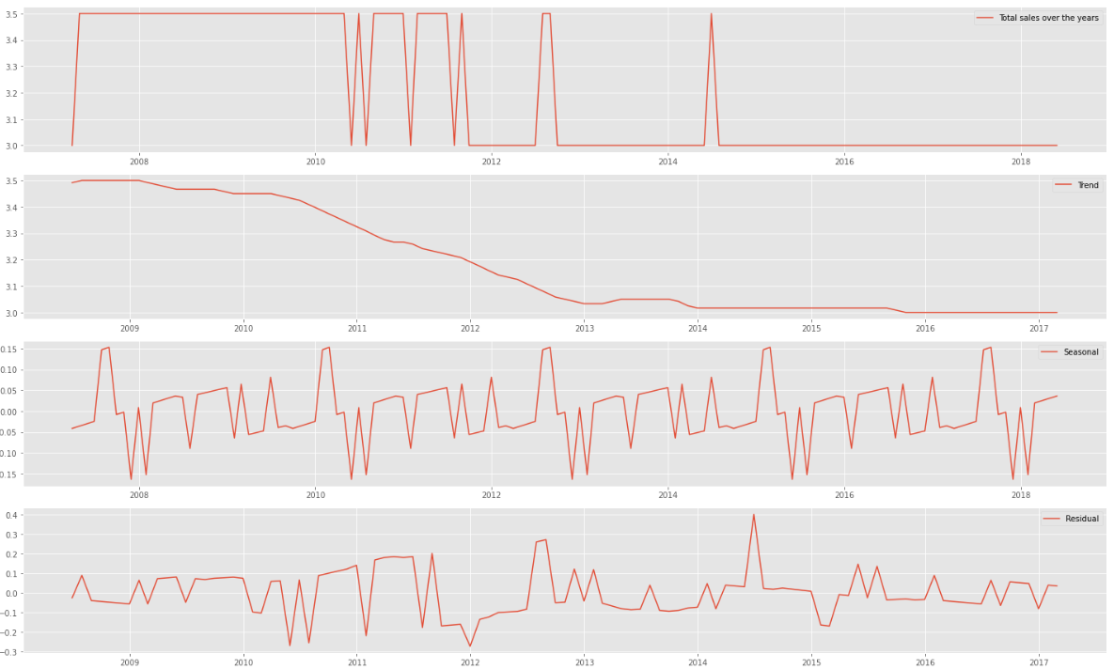
Decomposition plot for Positive, Negative and Neutral Sentiment Analysis
Positive Sentiment Analysis
In the decomposition graph we can see that there is an increasing trend in total sales after 2014 and the seasonality is present that means repetition of total sales in between specific time period over the years
Negative Sentiment Analysis
In the decomposition graph we can see that there is a increasing trend in total sales after 2011 and the seasonality is present that means repetition of total sales in between specific time period over the years
Neutral Sentiment Analysis
In the decomposition graph we can see that there is a increasing trend in total sales after 2014 and also the seasonality is present that means repetition of total sales in between specific time period over the years

Slide 22
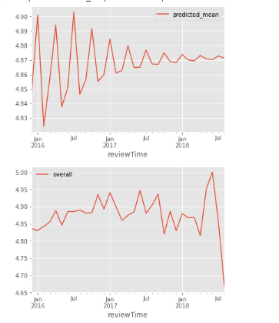
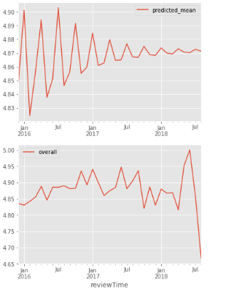
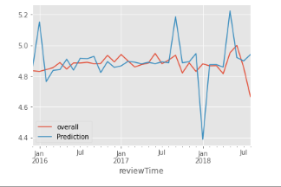
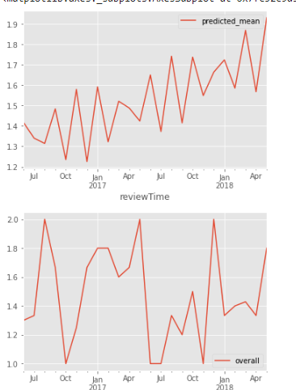
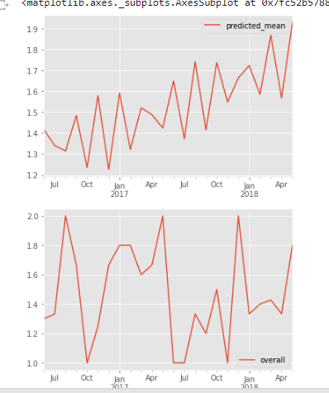
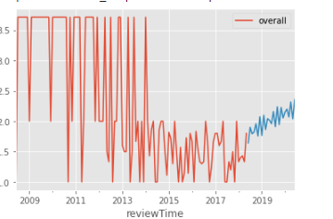
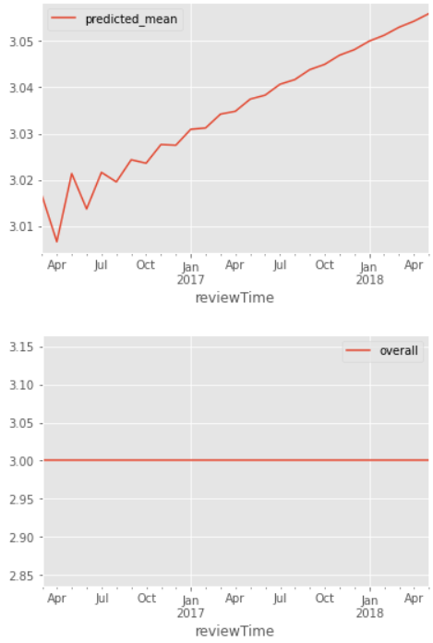
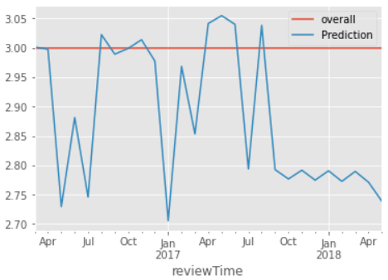
Positive, Negative and Neutral Sentiment ARMA, ARIMA AND SARIMA
Positive Sentiment Analysis
Negative Sentiment Analysis
Neutral Sentiment Analysis

Slide 23
Positive, Negative and Neutral Sentiment ARMA, ARIMA AND SARIMA
Here we can analyze by graph and RMSE score that our ARIMA model is giving less Error and SARIMA having more error though the difference isn’t huge.
Models | Positive(RMSE) | Negative(RMSE) | Neutral(RMSE)
ARMA | 0.08213 | 0.50952 | 0.03724
ARIMA | 0.08213 | 0.50952 | 0.03724
SARIMA | 0.29904 | 0.52337 | 0.16785

Slide 24
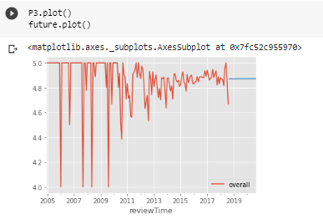
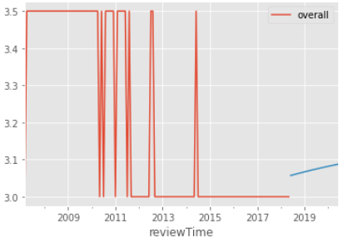
Forecast
Positive Sentiment Forecast
Positive Sentiment Forecast
Here is our future prediction for 2 years and it indicates that the positive review will be constant. The positive rating would be near 4.9.
Negative Sentiment Forecast
Negative Sentiment Forecast
Here is our future prediction for 2 years and it indicates that the Negative review will increase.
Neutral Sentiment Forecast
Neutral Sentiment Forecast
Here is our future prediction for 2 years and it indicates that the Neutral review will increase over the period.

Slide 25
Recommendation
To avoid the decrease in sale we can improve the quality of a product by initializing new innovative or custom themes.
we can apply some discounts and offers on the product
or fast action we would suggest manufacture company to keep hold on the production of this products for a while

Slide 26


